Slide 1
Languages of the British Isles

Slide 2
Фонетическая зарядка
suffer, sough, tough , rough, roughly
few, during, occupation, population
isles, primary, declining, revived, Highland
Welsh, Cornish, Irish

Slide 3
What do we mean by language?
What languages do you know?
What languages are the most spoken in the world?
In what countries do people speak English?
What is native language?
What is the UK?

Slide 4
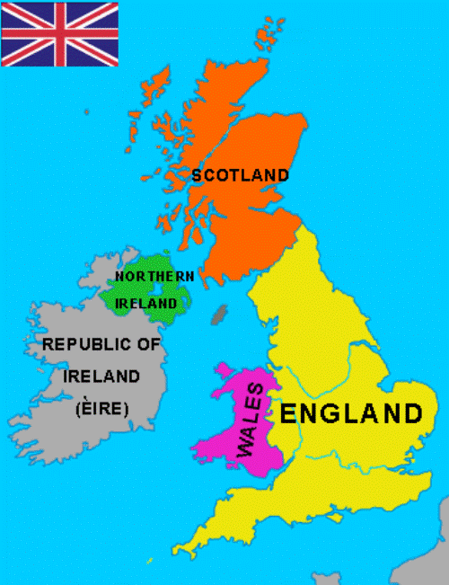

Slide 5
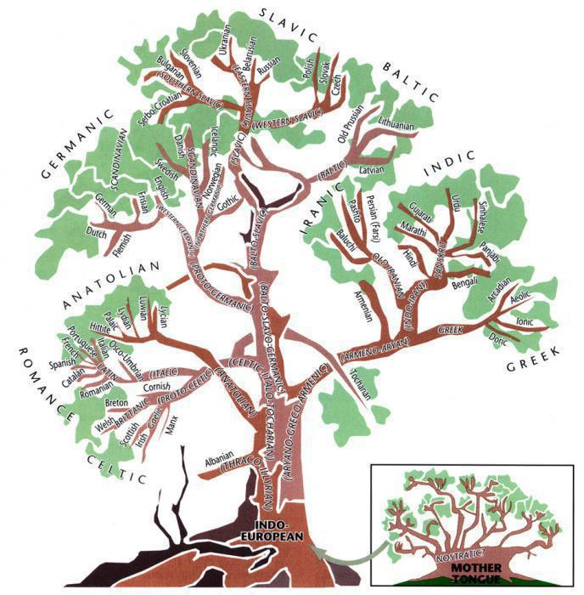

Slide 6
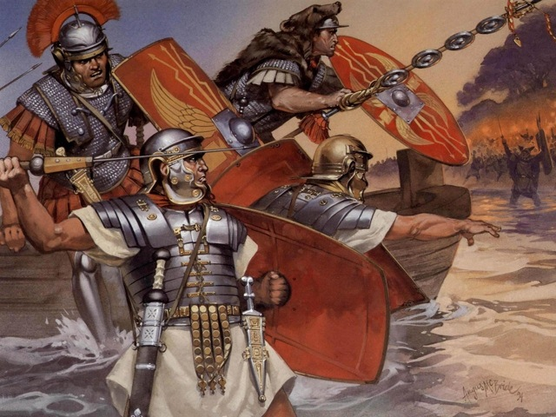
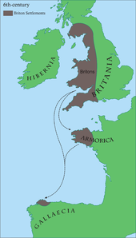
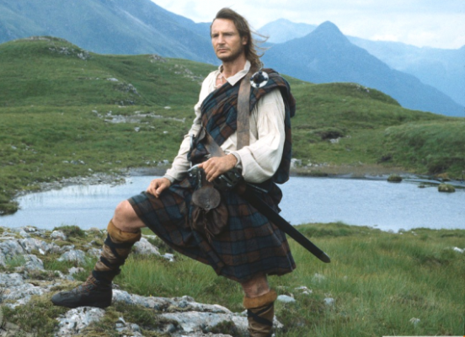
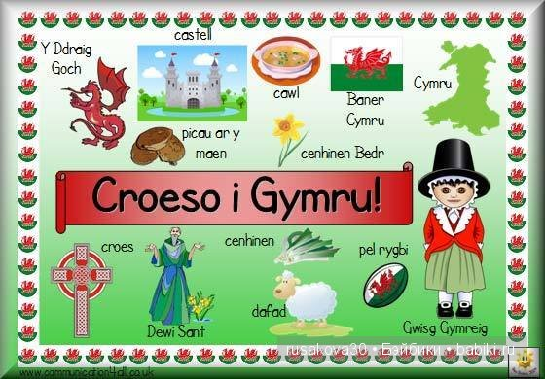
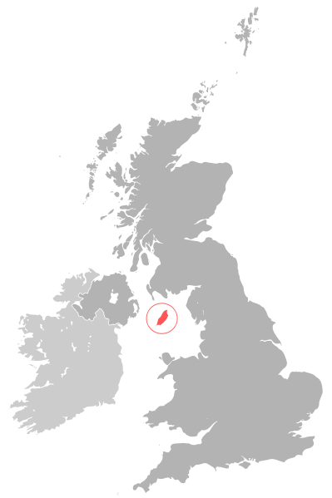
2
1
3
3
5
4

Slide 7
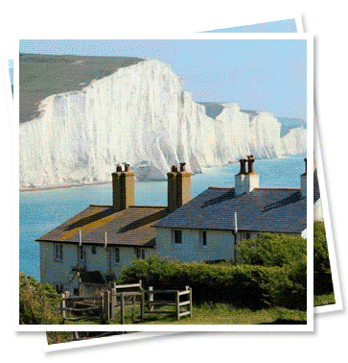
Thank you for the lesson

